Slide 1

Cryptocurrency
SC13 Group 5
Kway Yi Shen
Tan Wei Chuan
Charjan Avdhesh Shrikant

Slide 2
Agenda
01 Motivations
02 Prep Work
03 Core Analysis
04 Findings
05 Closing

Slide 3
Our Motivations
Popularity of cryptocurrency
Cryptocurrency gained traction in the past decade to the point where it is now widely used
Volatility of cryptocurrency
Cryptocurrency is known to be volatile, hence we are trying to see if it truly is unpredictable
01

Slide 4
Problem Definition
How can we find a way to predict future prices of cryptocurrencies based on past trends and prices?
01

Slide 5
Our Datasets
01

Slide 6









01

Slide 7

Pandas Data-Reader
01

Slide 8
Prep Work
02

Slide 9
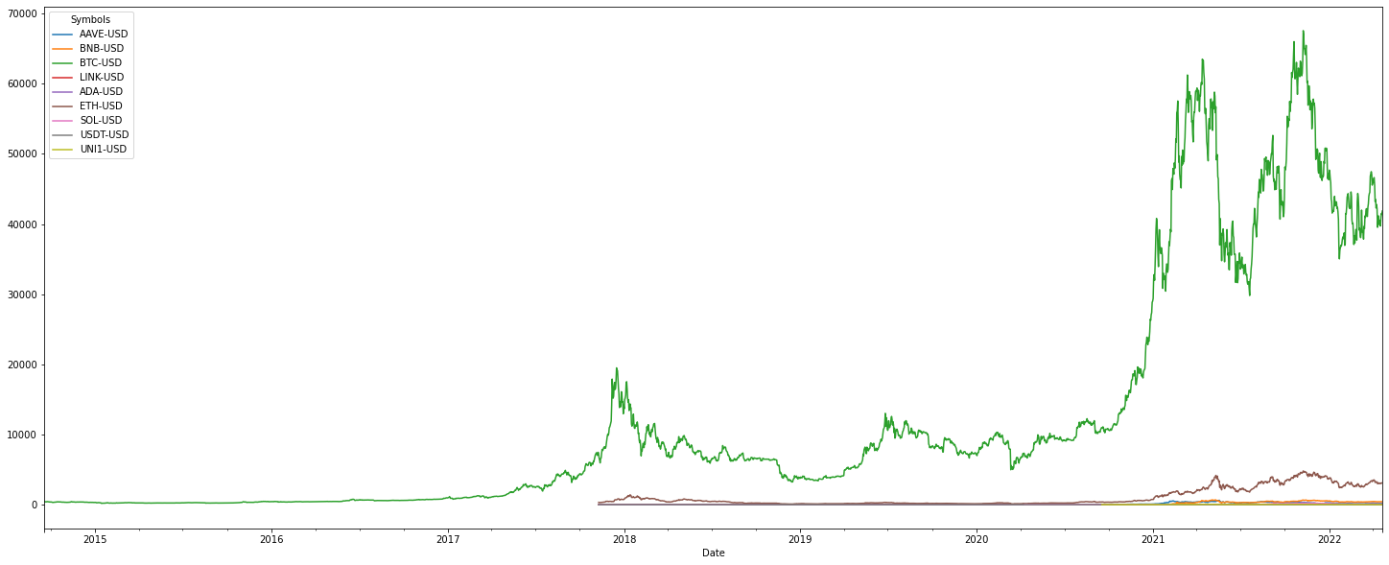

Slide 10
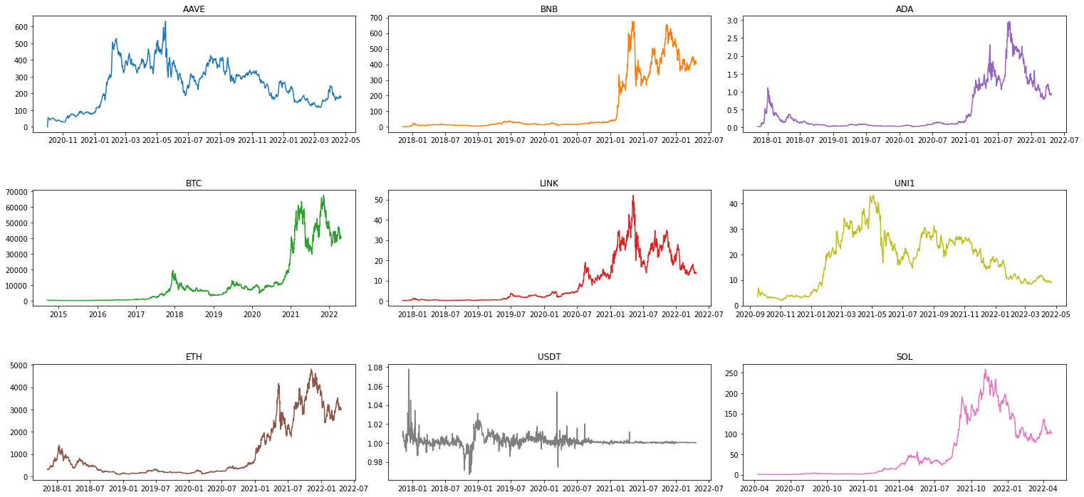

Slide 11
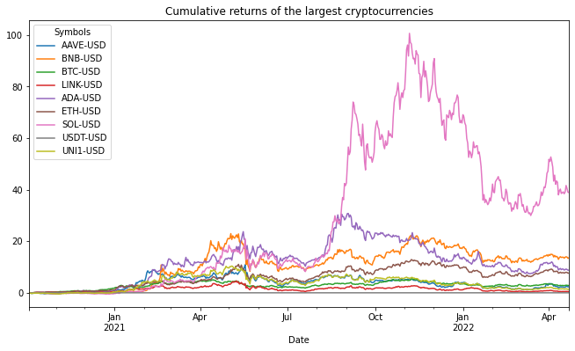

Slide 12
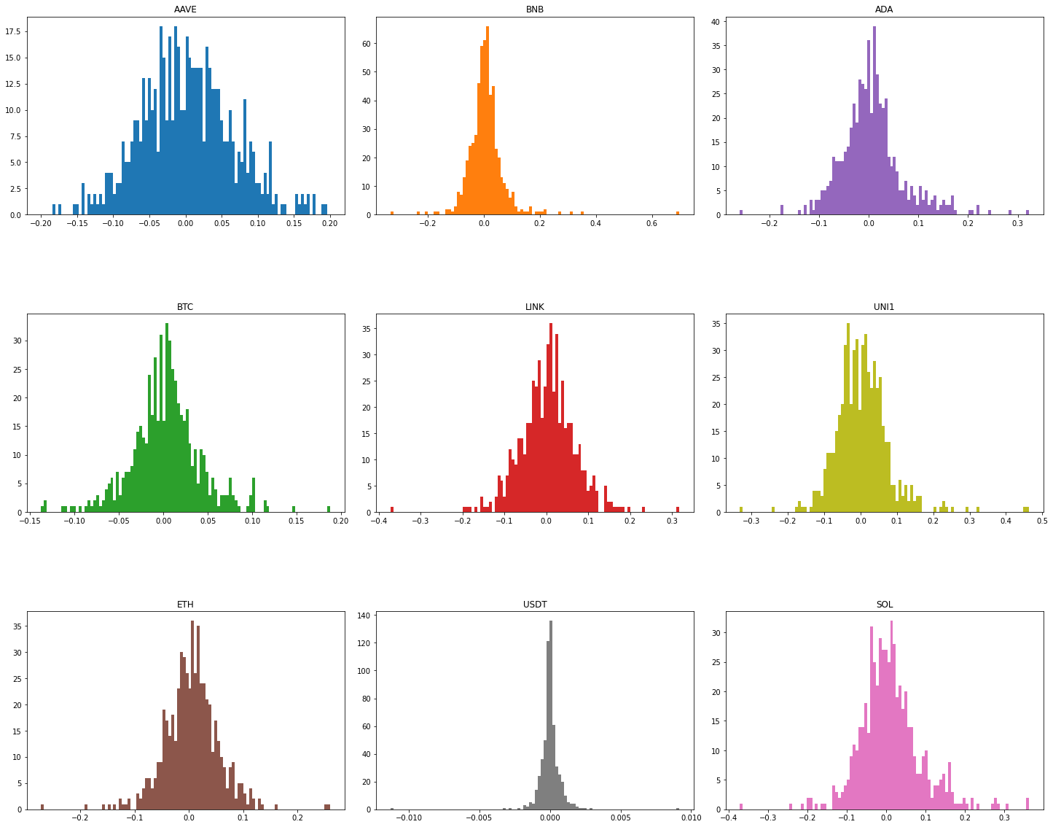
Notes:
Returns distribution (Histographs)

Slide 13
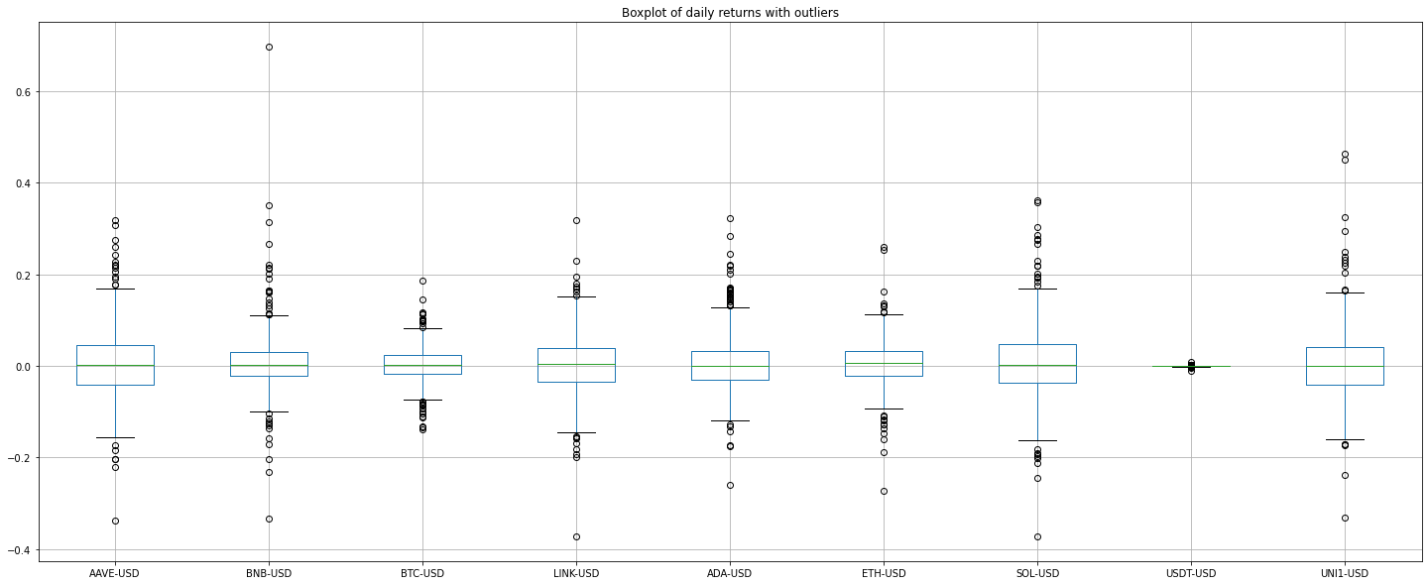
Notes:
Daily returns boxplot with outliers

Slide 14
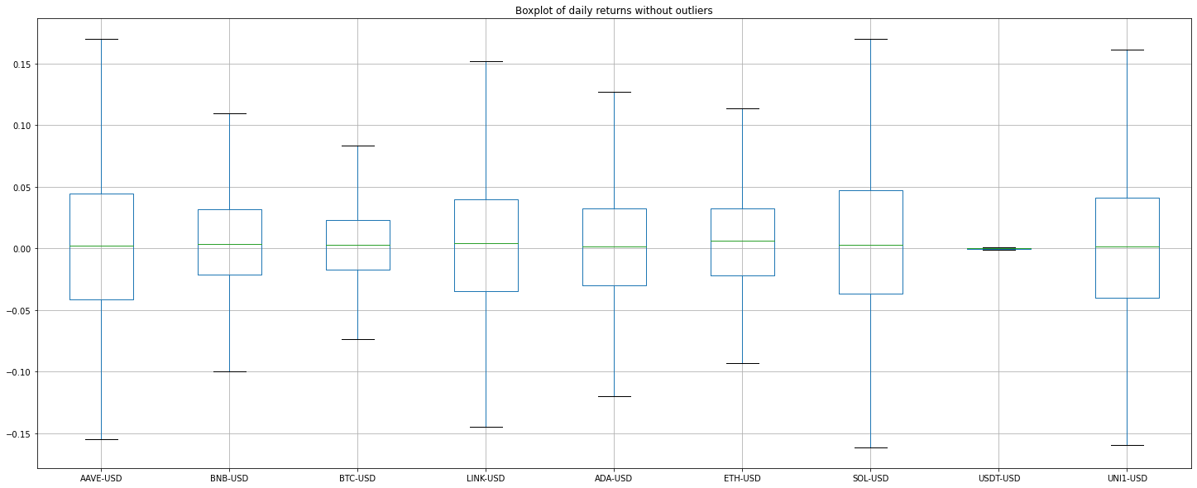
Notes:
Daily returns boxplot without outliers

Slide 15
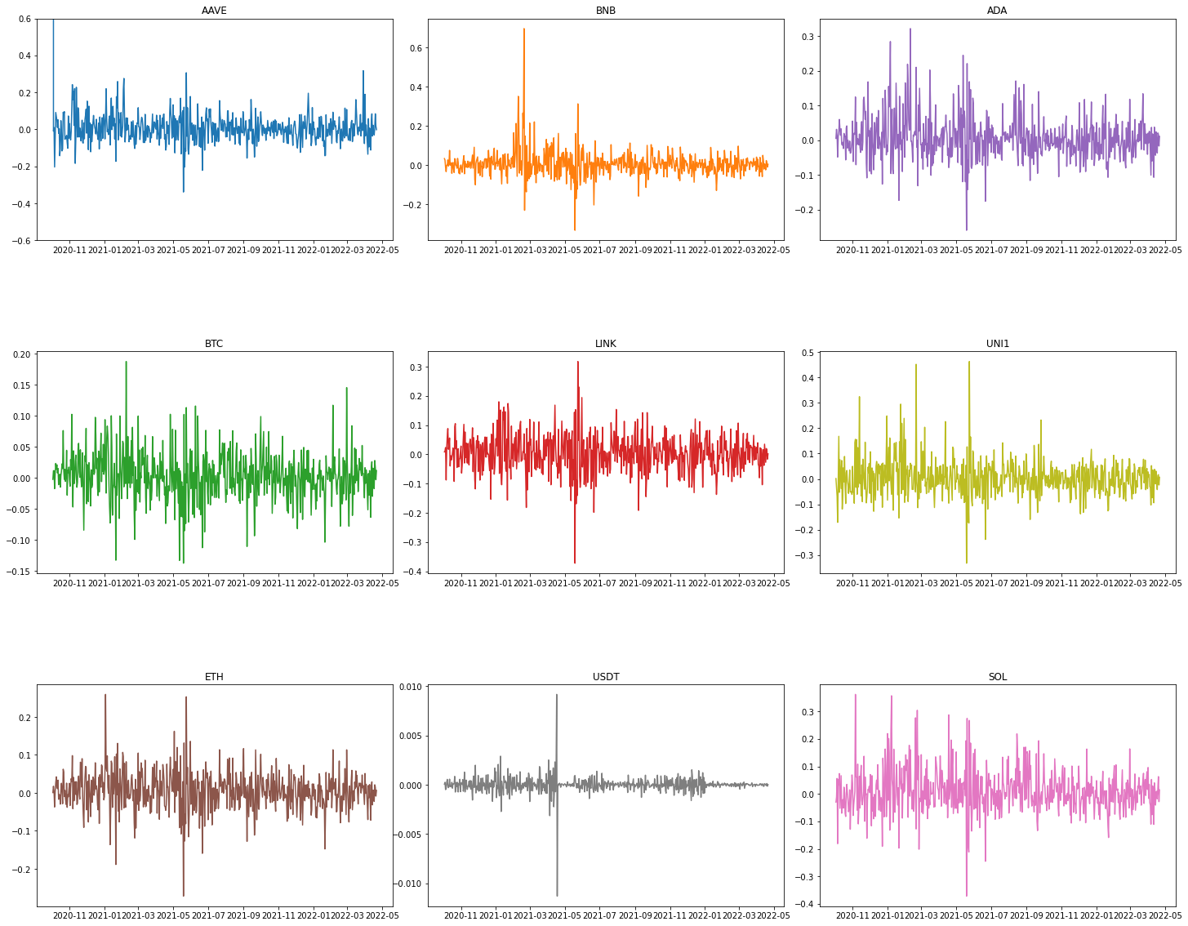
Notes:
Comparison of daily volatilities

Slide 16
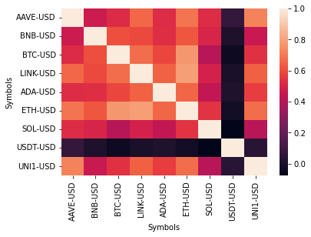
Notes:
Correlation Matrix of Crypto returns

Slide 17
Core Analysis
03

Slide 18

TensorFlow
LSTM
03

Slide 19
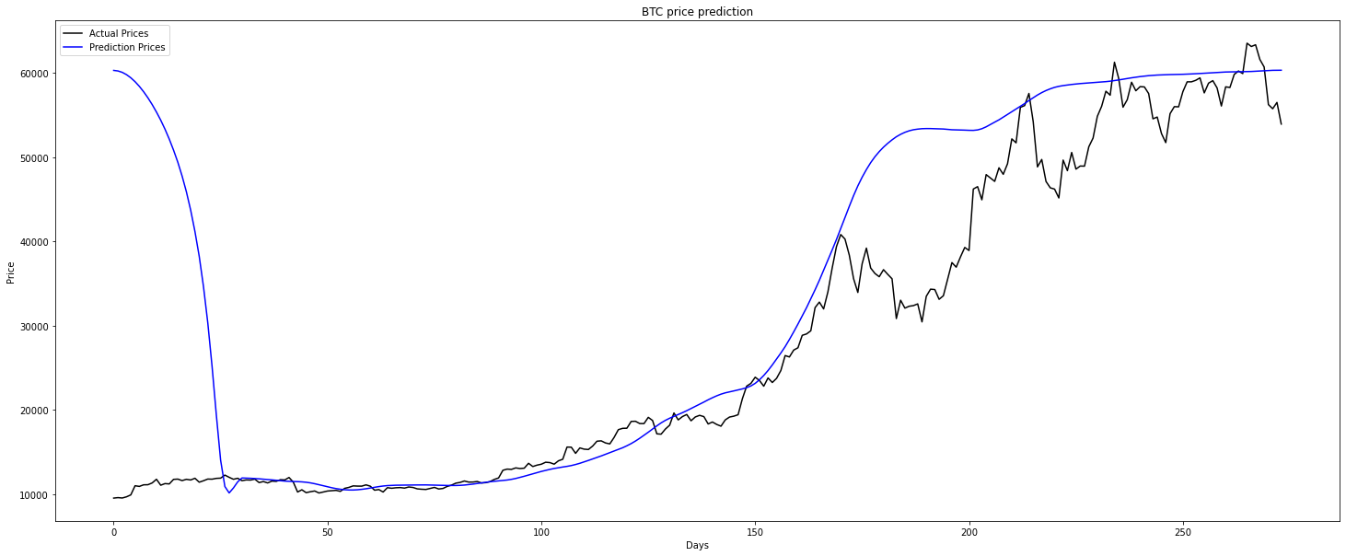
Using data till 1 year ago

Slide 20
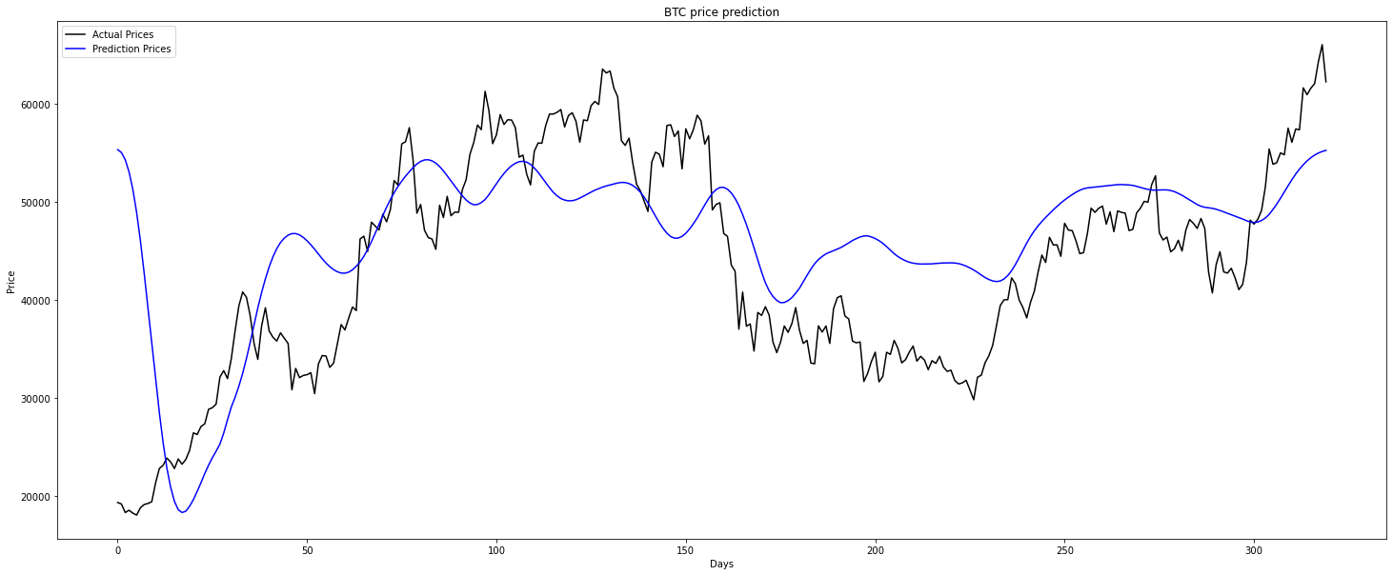
Using data till 6 months ago

Slide 21
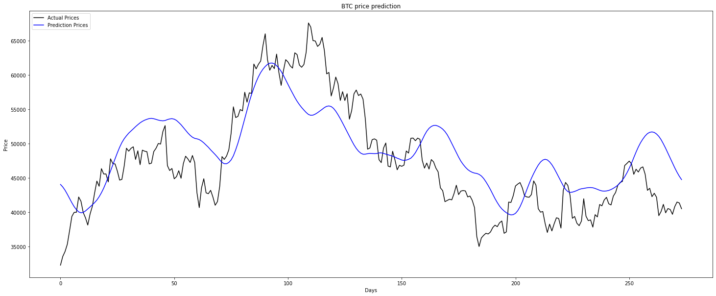
Using full data

Slide 22

Facebook Prophet
03

Slide 23
Prophet
Prophet is a method for forecasting time series data that uses an additive model to accommodate non-linear trends with annual, weekly, and daily seasonality
Works well with time series that have substantial seasonal impacts and historical data from several seasons.
03

Slide 24
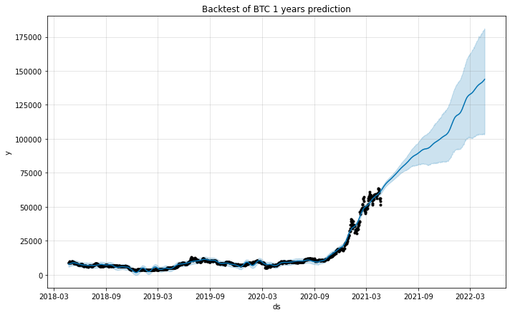

Slide 25
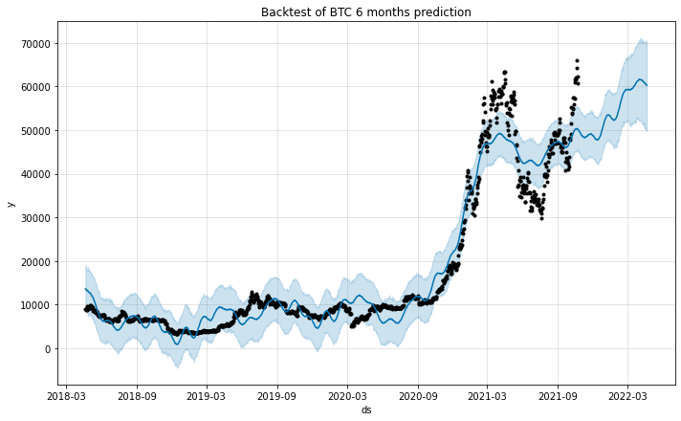

Slide 26
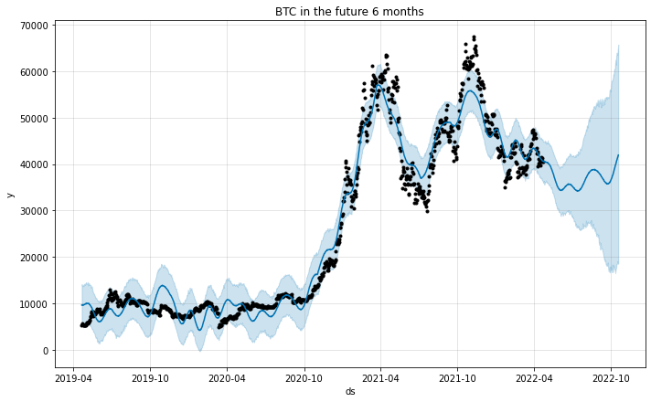

Slide 27
Results
Better than TensorFlow model
Prophet is resistant to missing data and trend alterations and handles outliers well
Possibility for further adjustments
03

Slide 28
Our Findings
04

Slide 29
How can we find a way to predict future prices of cryptocurrencies based on past trends and prices?
Plotted the predictions for each of the various cryptocurrencies
More accurate with more recent data
Unpredictability of cryptocurrency
04

Slide 30
Final Thoughts
05

